Slide 1

The data class a.k.a. the Pandas class (but it’s not)
Pietro Berkes & Verjinia Metodieva

Slide 2
Things one think about when thinking about data
Processing
Storage
Reproducibility and collaboration
Efficient processing (no for-loops!)
Organizing data so that analyses are easy
Size
Access ease
Access time
Versioning
Lineage tracing (which script / other data was used to generate this?)
Ease of sharing

Slide 3

Hands-on What data structure would you use to represent…

Slide 4
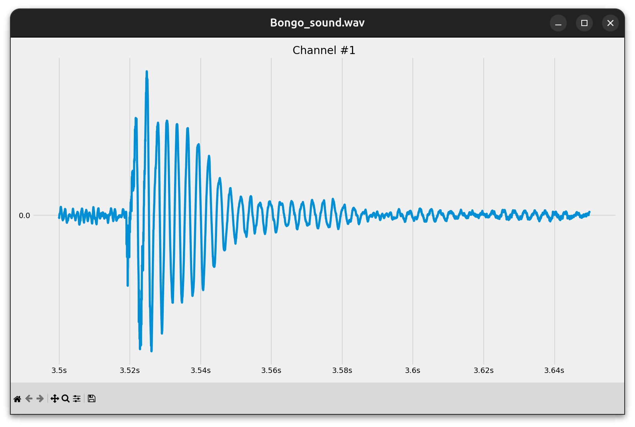
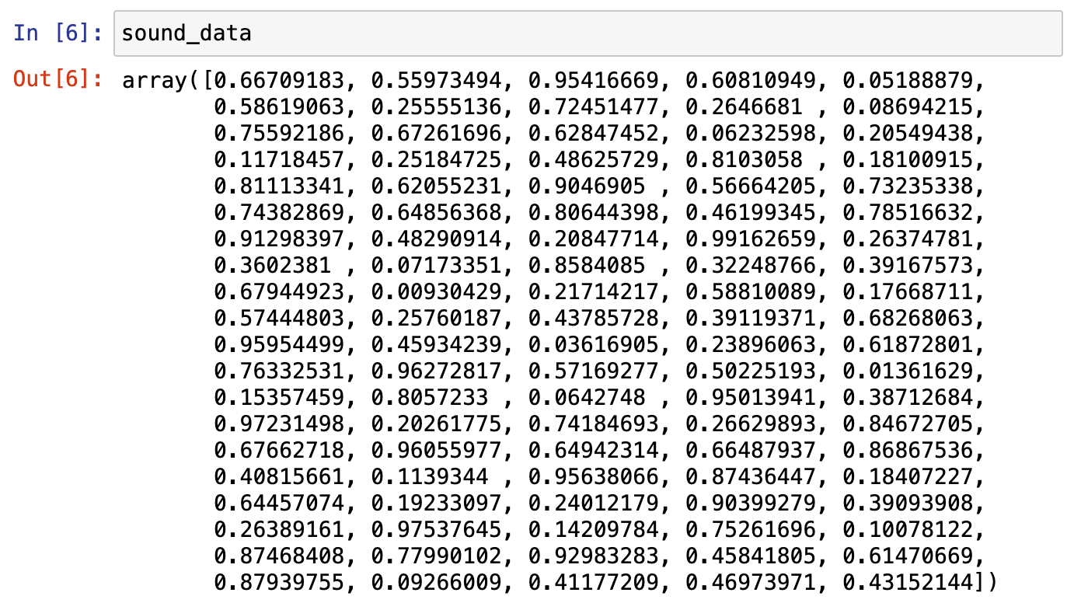
Hands-on What data structure would you use to represent…
A sound wave?
NumPy array

Slide 5
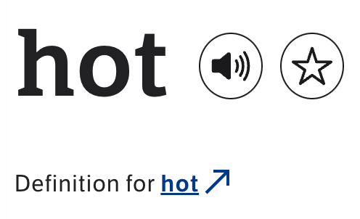
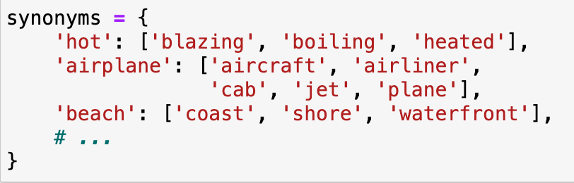
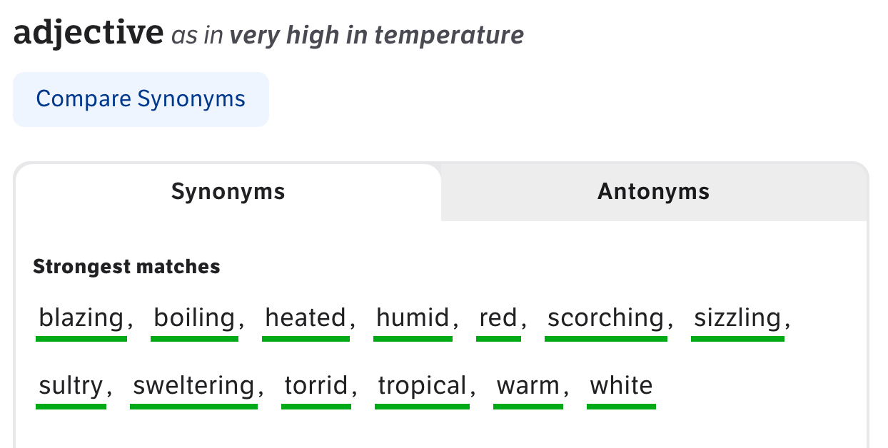
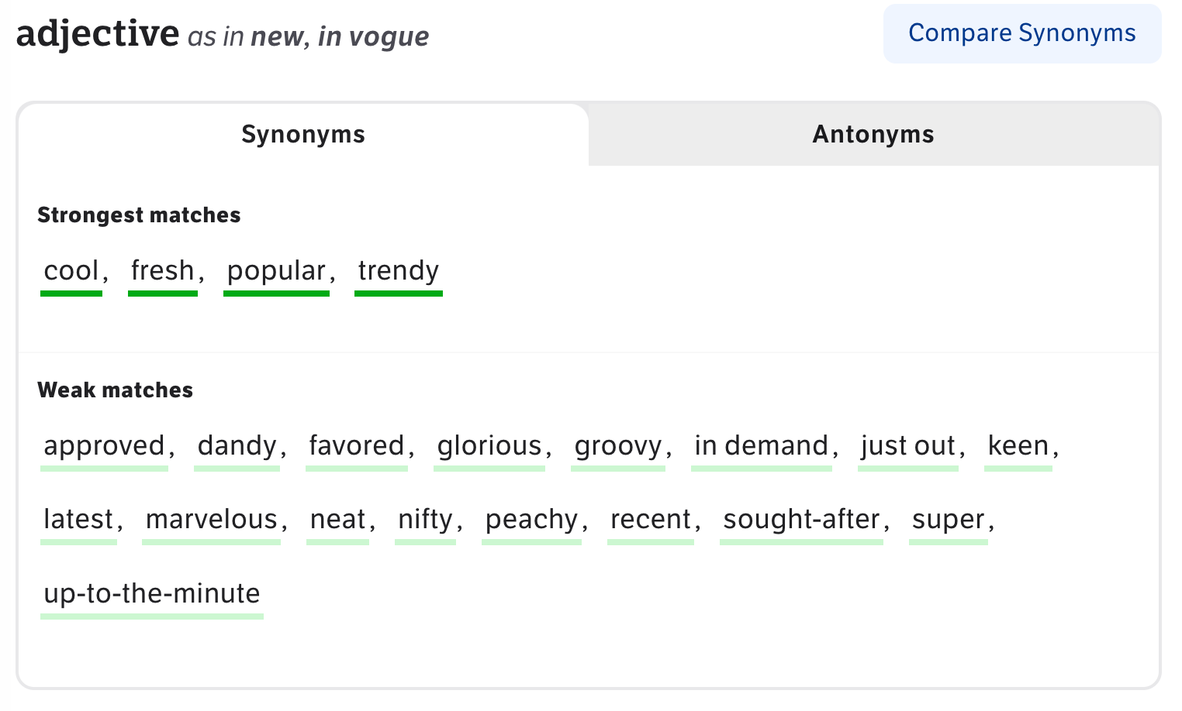
Hands-on What data structure would you use to represent…
A mapping between a word and its synonyms?
Dictionary

Slide 6
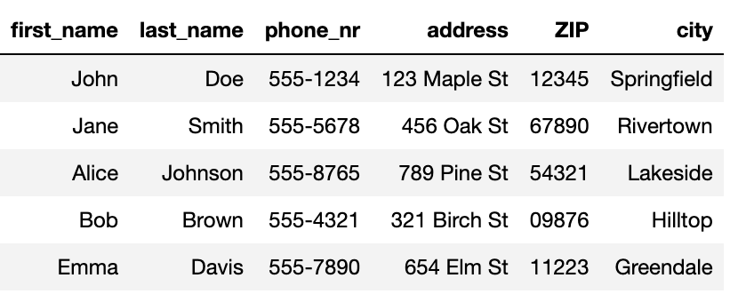
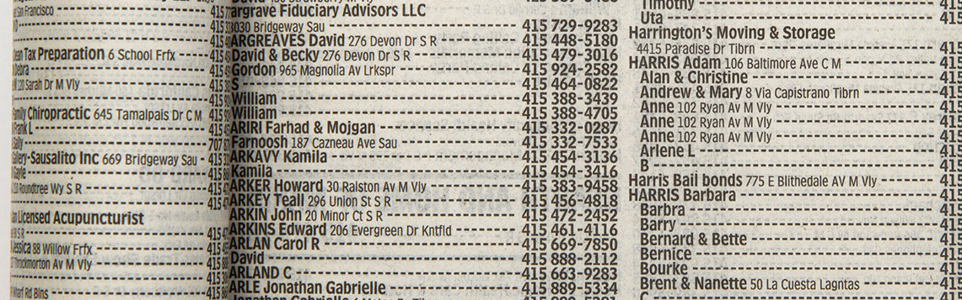
Hands-on What data structure would you use to represent…
Phone book entries?
Pandas DataFrame

Slide 7
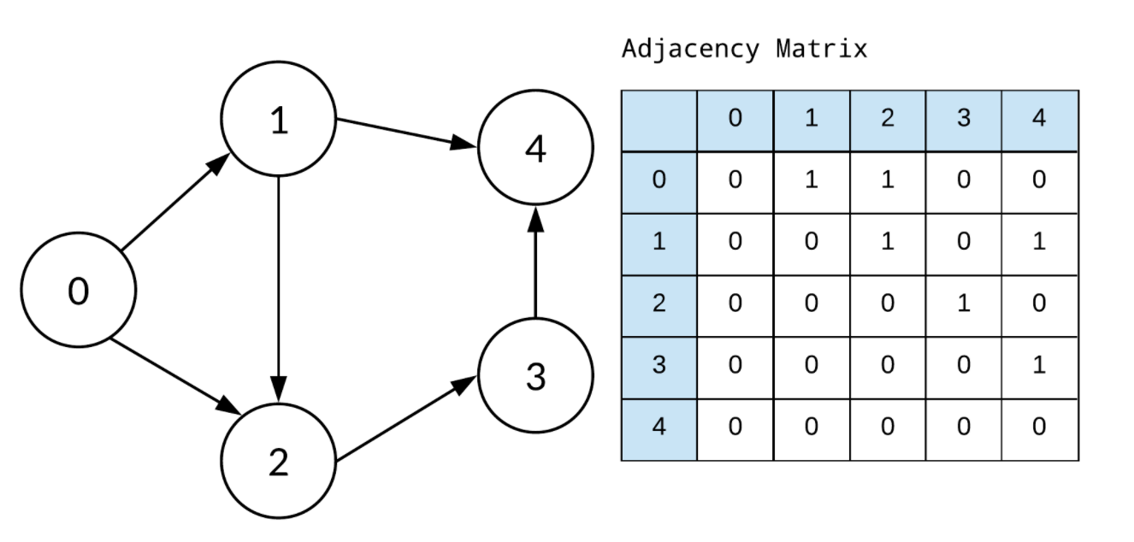





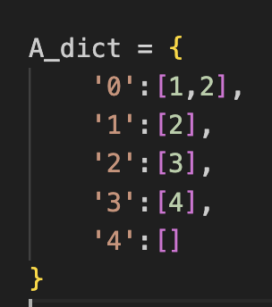
Hands-on What data structure would you use to represent…
Implemented as
Friendship relations?
Graph
Adjacency matrix (array)
Dictionary

Slide 8
You develop your code on a small data set, how is it going to scale to the complete data set?
Development data
Real data
N data points,
Processing time T
10x N data points
Processing time -> ?
We’re interested in orders of magnitude
Notes:
Data and code are related.
Nice transition from the last question. In extreme case, when the relations in the graph are dynamic/ changing a lot →using a dictionary is not a good solution. Instead, when small dataset and we are mainly interested in visualizing the relations, it might be.
The NumPy array solutions, scales much better, in case there are hundreds of dynamically changing relations to inspect.

Slide 9
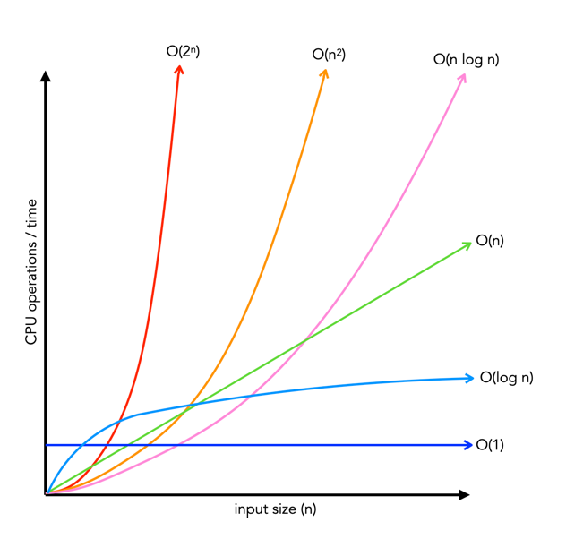
How performance scales: big-O
Big-O class | What we call it | Time increase, when data increases 10x
O(1) | constant | 1x time
O(n) | linear | 10x time
O(n²) | quadratic | 100x time
O(n * log n) | linearithmic | ~10-20x time
O(log n) | logarithmic | ~1-2x time
O(2^{n})
O(n²)
O(n log n)
O(n)
Time
O(log n)
O(1)
Input size, n

Slide 10
Hands-on: Operations on lists
Big-O class | What we call it | Time increase, when data increases 10x
O(1) | constant | 1x time
O(n) | linear | 10x time
O(n²) | quadratic | 100x time
O(n * log n) | linearithmic | ~10-20x time
O(log n) | logarithmic | ~1-2x time
O(2^{n})
O(n²)
O(n log n)
O(n)
Time
Big-O class | Operation on lists that scales this way
O(1)
O(n)
O(n²)
O(n * log n)
O(log n)
O(log n)
O(1)
Input size, n

Slide 11
Hands-on: Operations on lists
Big-O class | What we call it | Time increase, when data increases 10x
O(1) | constant | 1x time
O(n) | linear | 10x time
O(n²) | quadratic | 100x time
O(n * log n) | linearithmic | ~10-20x time
O(log n) | logarithmic | ~1-2x time
O(2^{n})
O(n²)
O(n log n)
O(n)
Time
Big-O class | Operation on lists that scales this way
O(1) | Getting an element by its index
O(n) | Summing elements in list
O(n²) | Computing distance between all pairs of elements in the list
O(n * log n) | Sorting the list
O(log n) | Searching an element in a sorted list
O(log n)
O(1)
Input size, n

Slide 12
Example: Find common words
Given two lists of words, extract all the words that are in common
Expected result: ['apple', 'orange', 'banana']

Slide 13
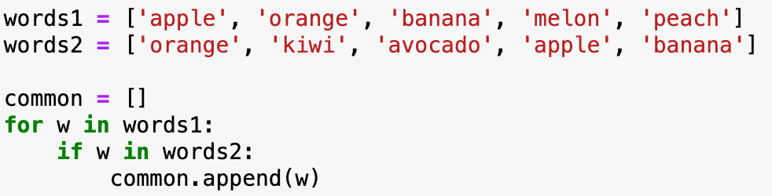
Implementation with two for-loops
What is the big-O complexity of this implementation?

Slide 14
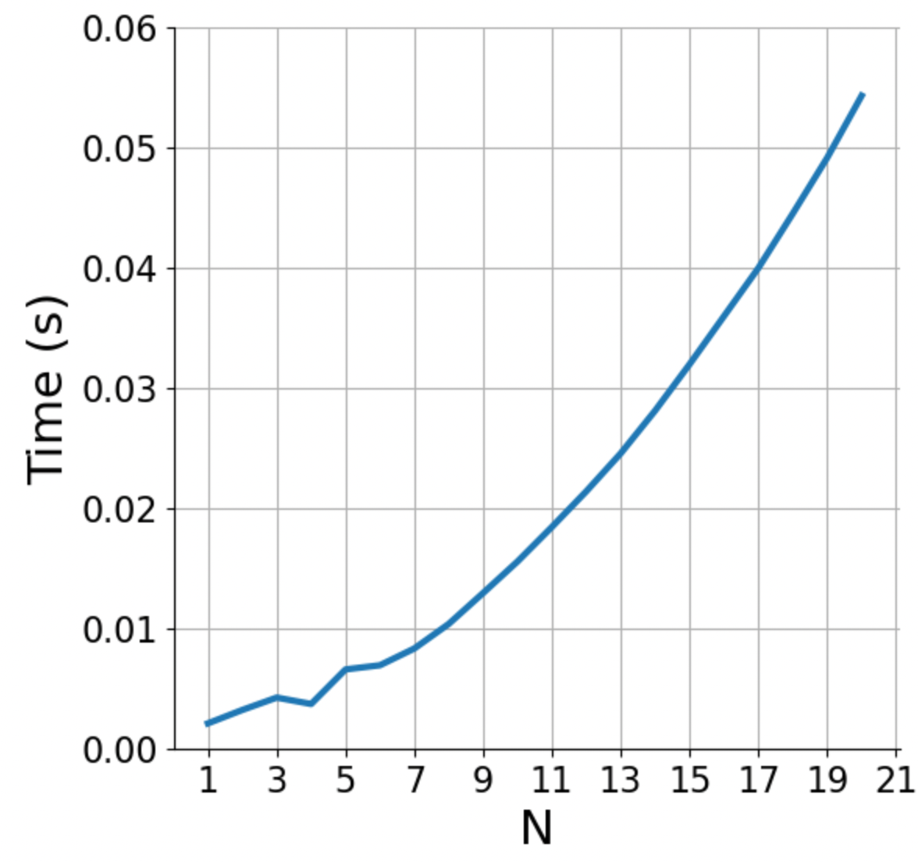
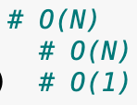
Implementation with two for-loops
What is the big-O complexity of this implementation?
N * N ~ O(N²)

Slide 15
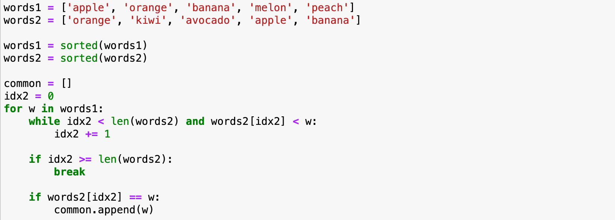
Implementation with sorted lists
What is the big-O complexity of this implementation?

Slide 16
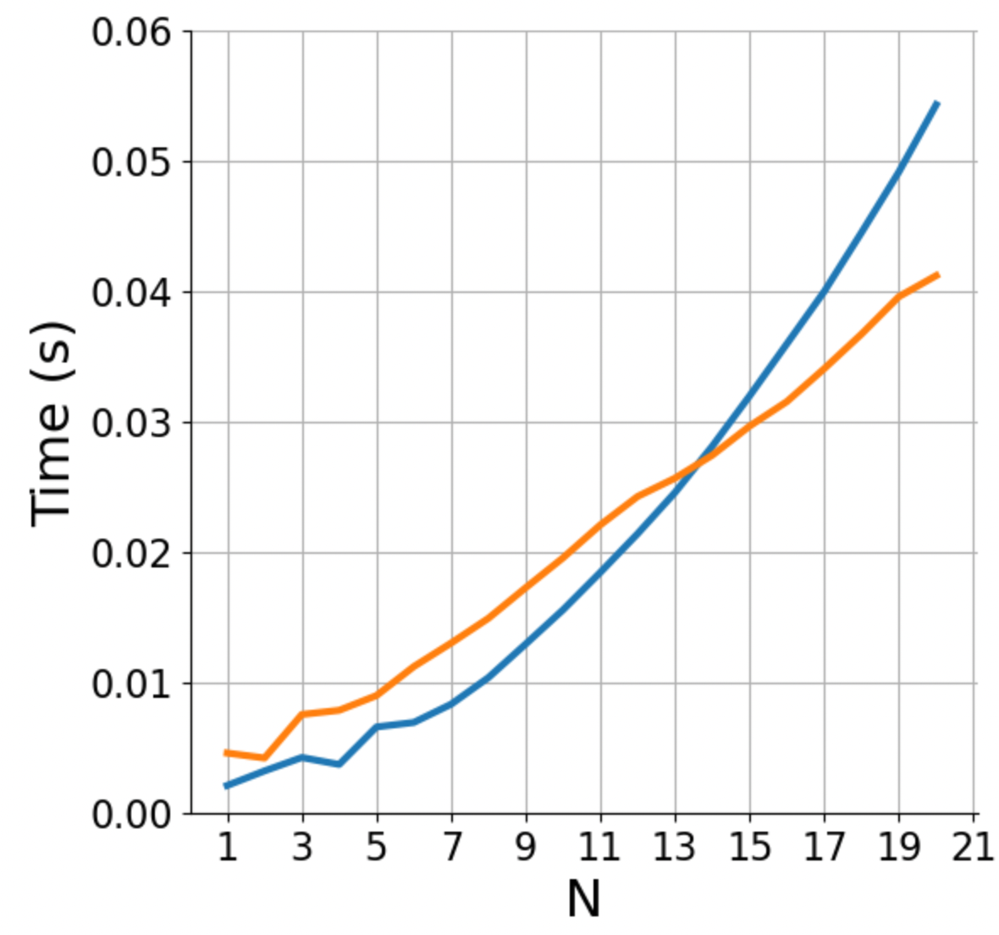

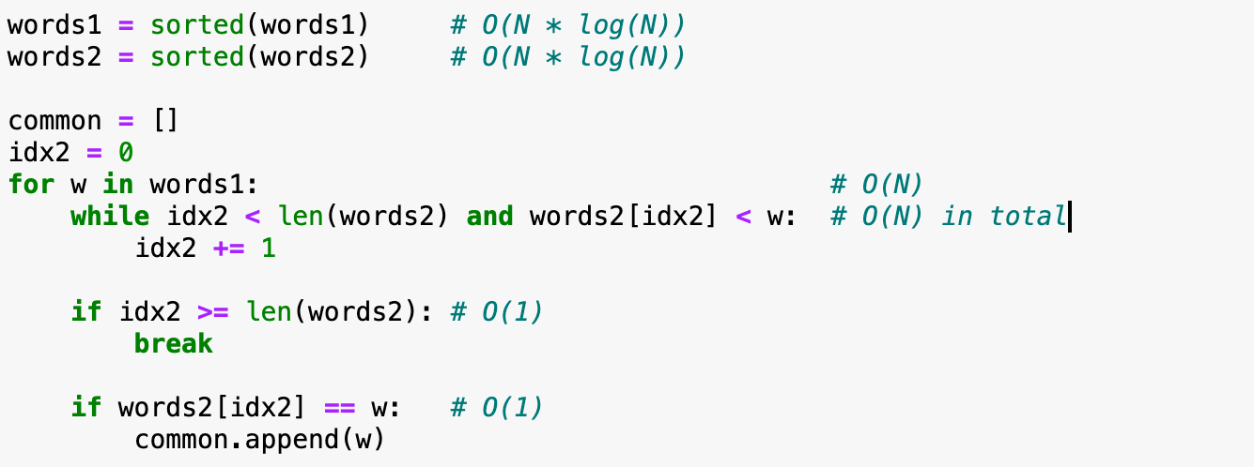
Implementation with sorted lists
What is the big-O complexity of this implementation?
2 * (N * log(N)) + 2 * N ~ O(N log N)

Slide 17
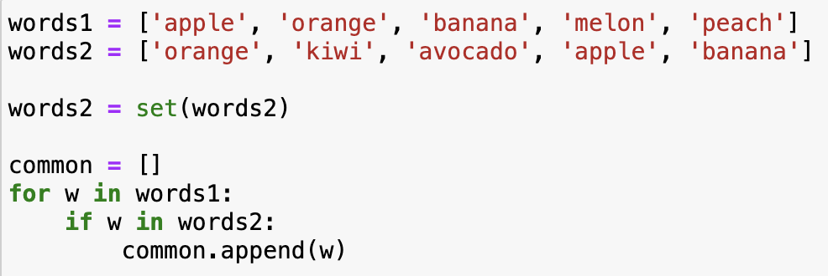
Implementation with sets
What is the big-O complexity of this implementation?

Slide 18
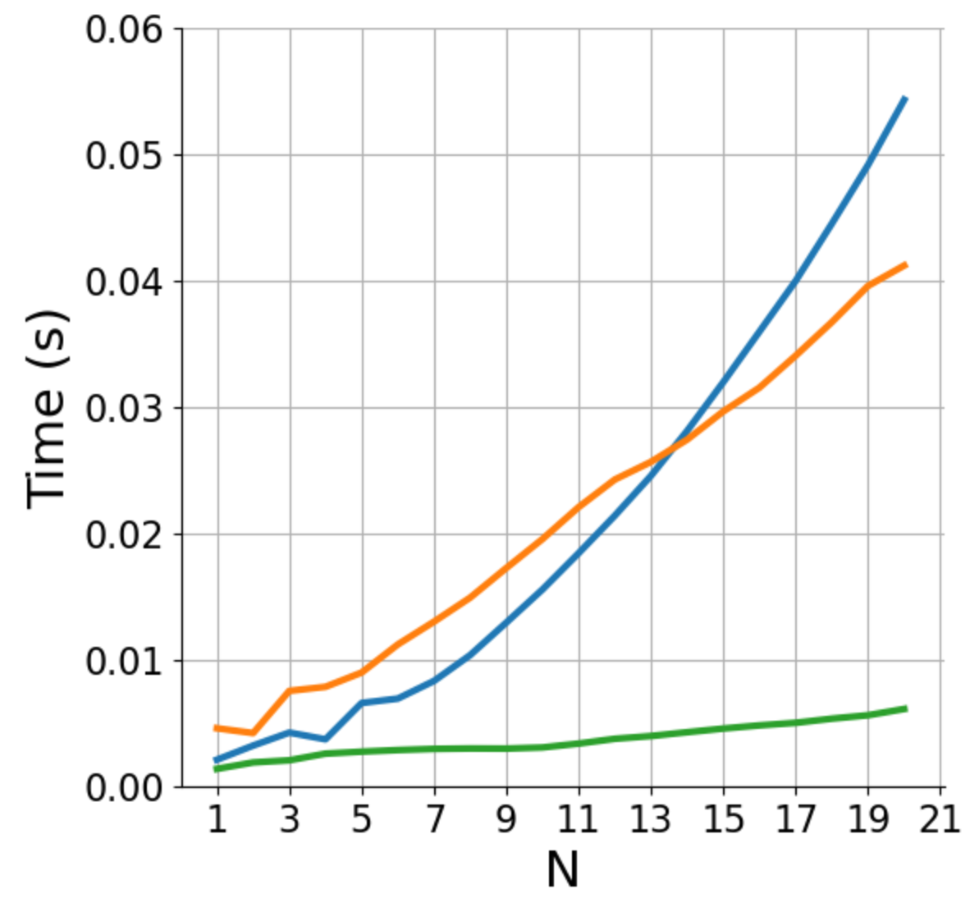
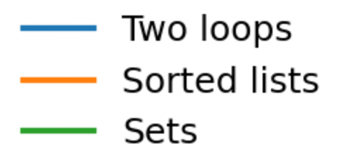
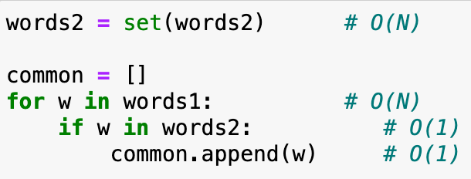
Implementation with sets
What is the big-O complexity of this implementation?
N + N ~ O(N)

Slide 19
Basic reference sheet about Python data structures
Lists: collection of ordered, arbitrary data
Dictionaries (“hashmaps”)
Inserting | O(1)
Finding a value by key (e.g., “if element in my_dict: …”) | O(1)
Getting an element by index | O(1)
Appending | O(1)
Inserting an element at index | O(n)
Sorting | O(n log n)
Finding an element (e.g., “if element in my_list: …”) | O(n)
Sets: it’s dictionaries without values
Inserting | O(1)
Finding a value by key (e.g., “if element in my_set: …”) | O(1)
See also: https://wiki.python.org/moin/TimeComplexity
Notes:
Note that there may be different implementations of these data structures with different complexities, these are for the Python implementation.
E.g., if finding an element in a list is important, one could implement it as two dictionaries, one mapping indices to data, one mapping data to indices. Finding out the complexities of all the operations with this implementation is left as a homework.

Slide 20
Hands-on
Exercise
exercises/anagrams
You are given an English dictionary containing M words (“the dictionary”), and a separate list of N words (“the input”)
For each word in the input, find all the anagrams in the dictionary (e.g., for input 'acme' the anagrams are ['acme', 'came', 'mace’])
Write an algorithm to solve this problem, and compute its Big-O class
Submit a PR for Issue #1 on GitHub

Slide 21
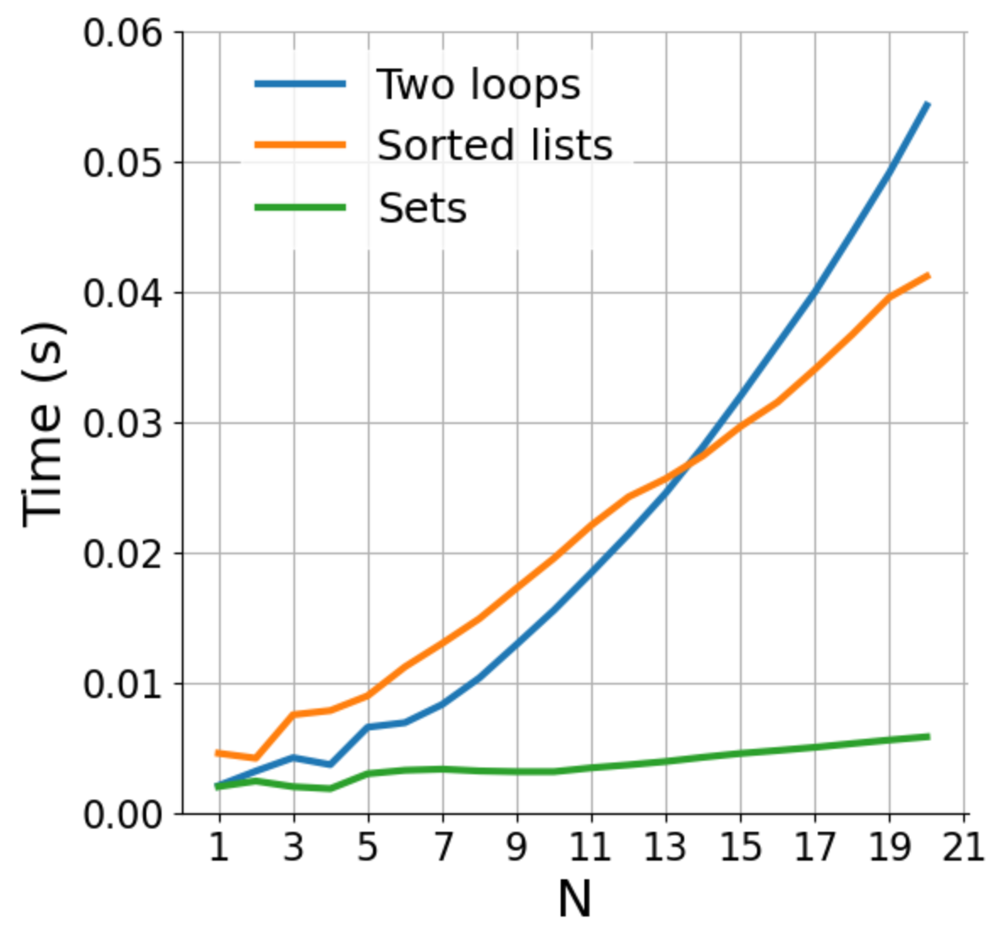
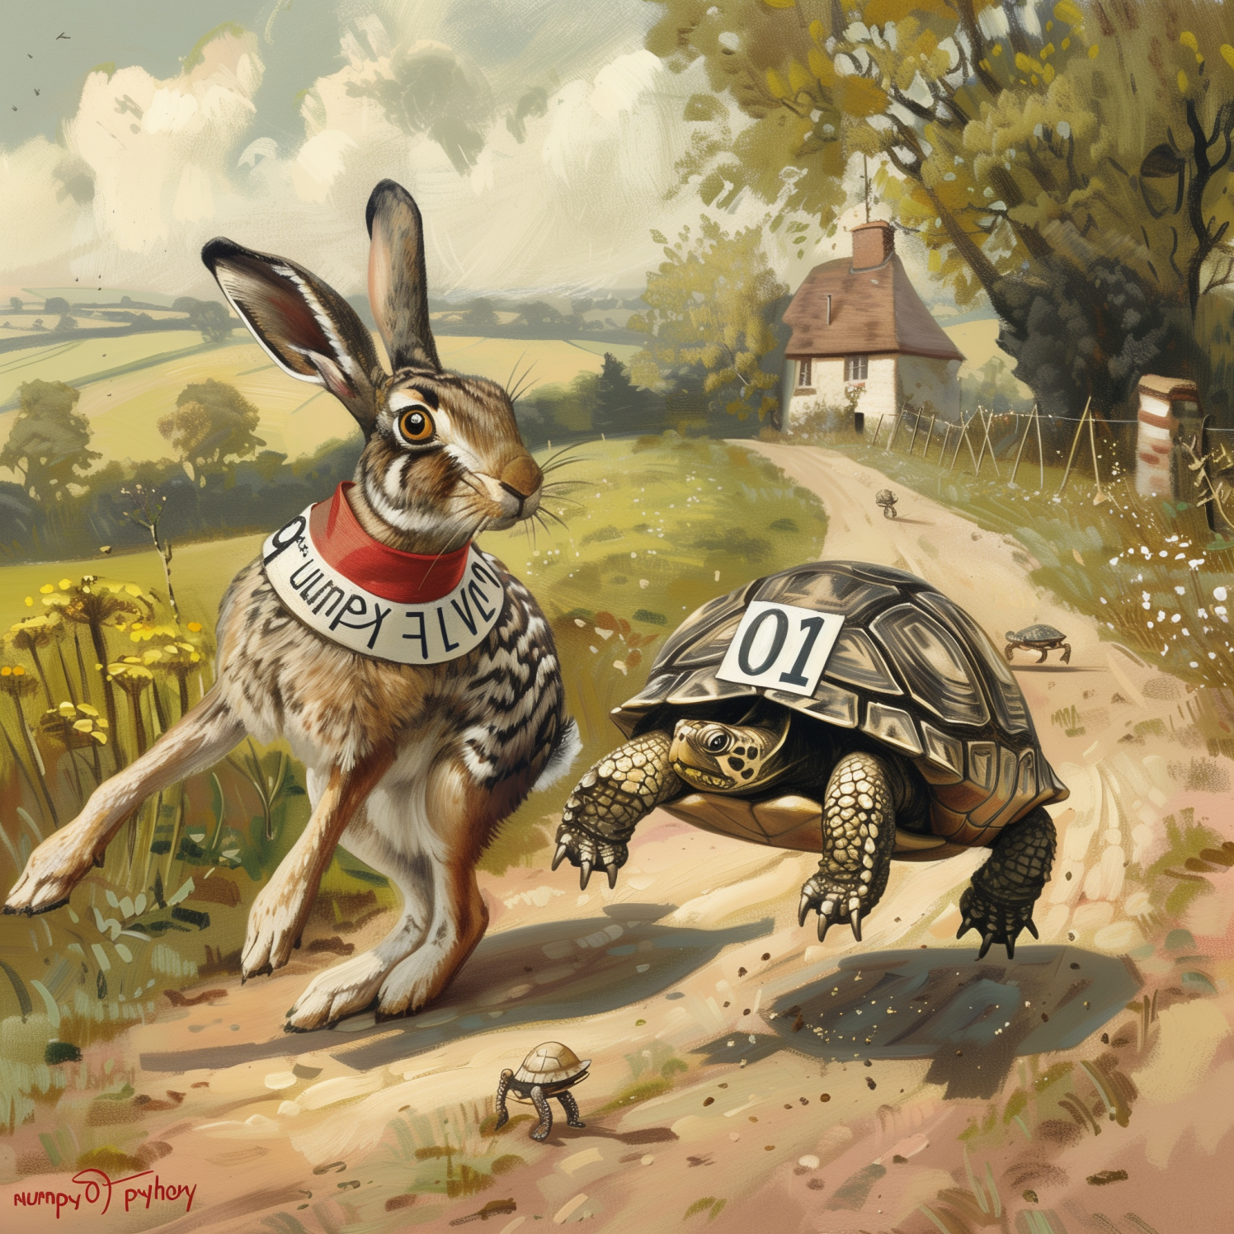
How does rewriting in C change the performance? (rewriting in C, parallelization; same algorithm)
Fast execution
Slow scaling O(n²)
Fast code
O(n²)
Regular code
O(n log n)
Slow execution
Fast scaling O(n log n)
Notes:
Parallelization lowers the curves.
For a fixed code, linear code is no necessarily faster.
Important when n is growing
Parallelization/ optimization → you can make the code faster for any fixed N, but the shape (of growth) can never change

Slide 22
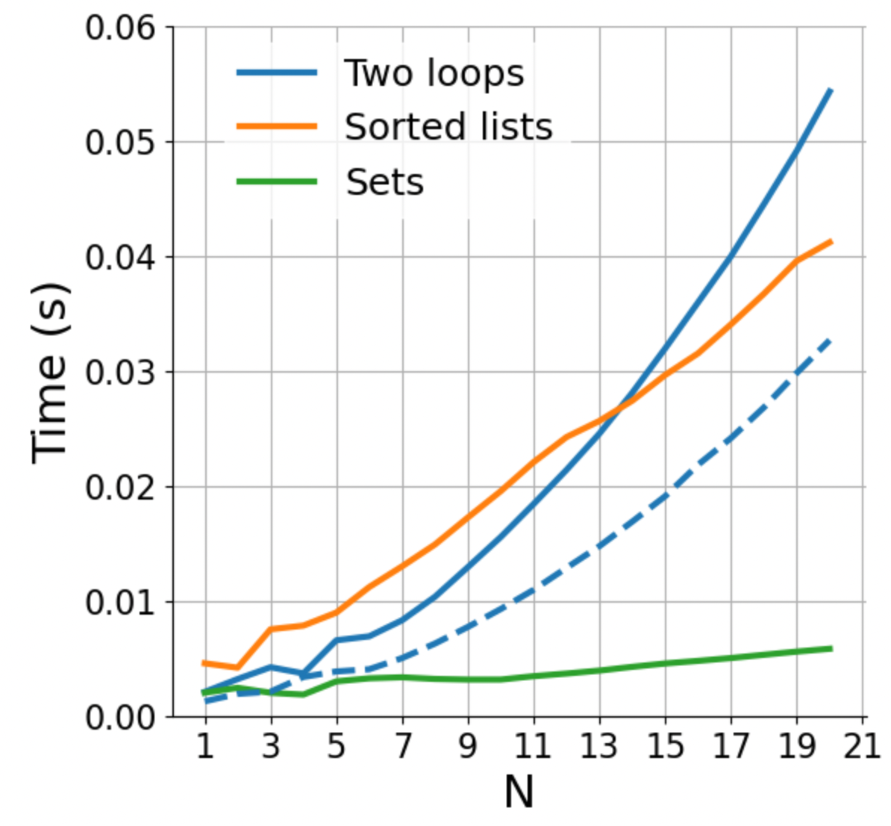
How does rewriting in C change the performance? (rewriting in C, parallelization; same algorithm)
Faster language increases performance for fixed N
Fast code
O(n²)
Regular code
O(n log n)
Notes:
Parallelization lowers the curves.
For a fixed code, linear code is no necessarily faster.
Important when n is growing
Parallelization/ optimization → you can make the code faster for any fixed N, but the shape (of growth) can never change

Slide 23
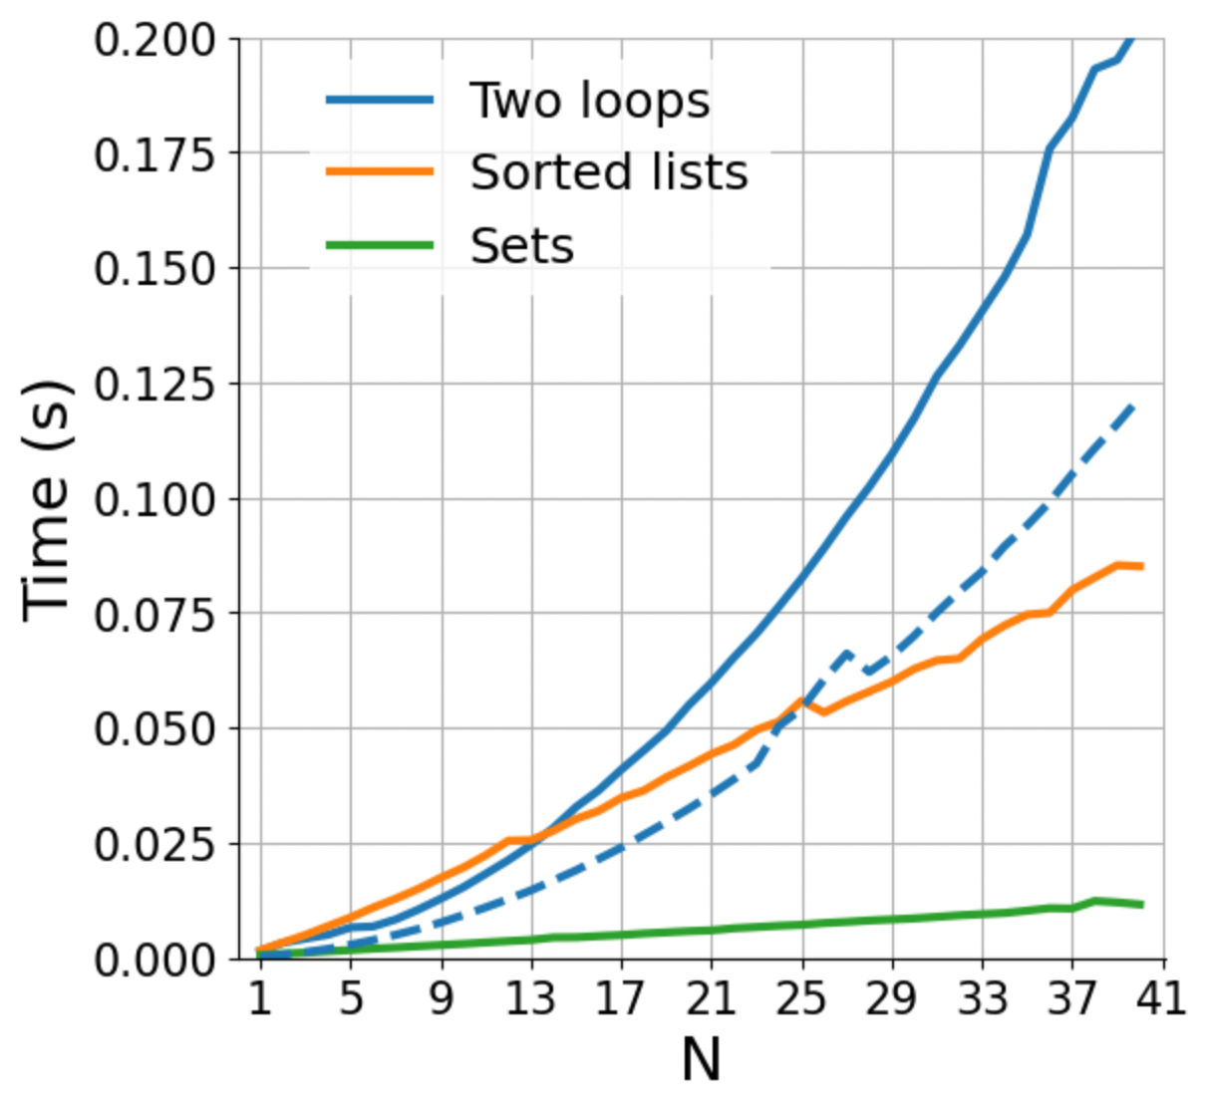
How does rewriting in C change the performance? (rewriting in C, parallelization; same algorithm)
Fast code
O(n²)
Regular code
O(n log n)
Notes:
Parallelization lowers the curves.
For a fixed code, linear code is no necessarily faster.
Important when n is growing
Parallelization/ optimization → you can make the code faster for any fixed N, but the shape (of growth) can never change

Slide 24
How does rewriting in C change the performance? (rewriting in C, parallelization; same algorithm)
Fast code
O(n²)
We need to distinguish between “fast” in absolute terms for a fixed problem size, and “fast” in the sense of how well it scales
Regular code
O(n log n)
Notes:
Parallelization lowers the curves.
For a fixed code, linear code is no necessarily faster.
Important when n is growing
Parallelization/ optimization → you can make the code faster for any fixed N, but the shape (of growth) can never change

Slide 25
COMING UP NEXT: NumPy and the array data structure

Slide 27
All the data structures
list: ordered, heterogeneous storage, stack/queue, fast access by index, slow search
set: unordered
dictionary
arrays: e.g. numpy, HDF5
tables: e.g. pandas, dask, spark, SQL
graph: social network structure
tree: to rapidly search a dataset
heap
stack
queue
priority queue

